Slide 1
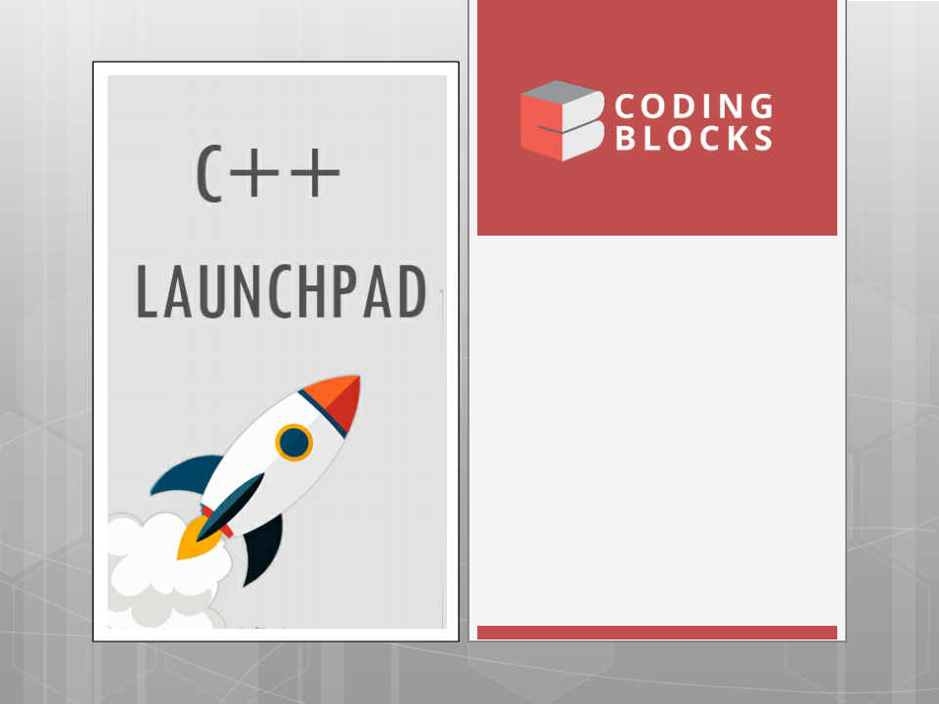
Lecture-8
Recursion
•
Understanding Recursion
Problems
•
on Recursion
Merge Sort
•
1
Kartik
Mathur

Slide 2

2
Call Stack!

Slide 3
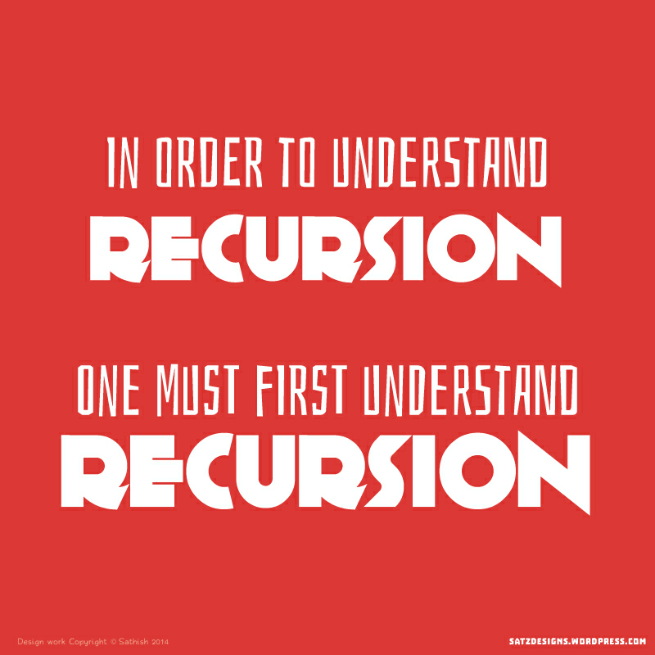
3
How to understand Recursion ?

Slide 4
4
Time to talk about Recursion!

Slide 5
5
What is Recursion?
Recursion in computer science is a method
where the solution to a problem depends on
solutions to smaller instances of the same
Problem.

Slide 6
Parts of Recursive Algorithm
Base Case (i.e., when to stop)
Work toward Base Case
Recursive Call (i.e., call ourselves)
The "work toward base case" is where we
make the problem simpler. The recursive call, is
where we use the same algorithm to solve a
simpler version of the problem. The base case
is the solution to the "simplest" possible problem

Slide 7
Print Factorial of N
What is the recursive call?
What is the base case?

Slide 8
8
Print Nth Fibonacci Number
What is the recursive call?
Base Case?

Slide 9
9
Behind the scenes!

Slide 10
10
Check if an array is sorted
What is the recursive call?
Base Case?

Slide 11
11
Lets code some more problems
Sum of Array
Selection Sort
Print Numbers –
1) Increasing Order
2) Decreasing Order

Slide 12
12
Your Turn
Write code for a function power(x,n) which
evaluates x^n.
Given an integer say –
2048 , print “two zero four eight” using
recursion.
Given an array
Check if it contains 7
Find first index of 7
Find last index of 7
Find all indices of 7

Slide 13
Time to try?
Multiply two numbers using recursion
Bubble Sort using recursion.
Binary Search using recursion.
Convert a String into Integer using recursion.

Slide 14
14
Merge Sort!

Slide 15
15
Tower Of Hanoi?

Slide 16
16
What is next class about?
More into recursion.

Slide 17
Thank You!
Kartik Mathur
17

